Slide 1
The discovery of the nucleus

Slide 2
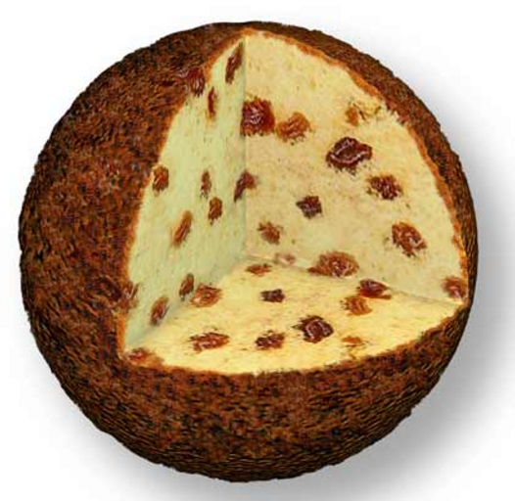
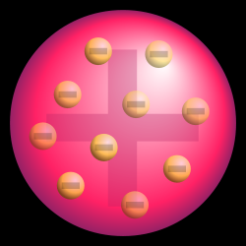
Thomson’s plum-pudding model of atoms
Negatively charged electrons are embedded in a uniform positively charged sphere.
Notes:
Thomson在发现了第一种亚原子粒子-电子后，就提出了一个原子模型。在那个年代人们刚刚开始接受原子的概念，对原子的图像还是非常模糊的。
Thomson认为：由于原子是中性的，电子带负电且质量很小，大约只有氢原子的1800分之一。原子中应该及质量更大的物质，并且携带和电子总电量相等的正电荷。他认为这些正电荷是均匀分布在这中大质量物质里的。这就是Thomson的原子模型，也称葡萄干布丁模型。

Slide 3
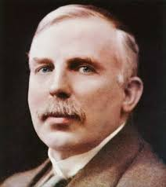
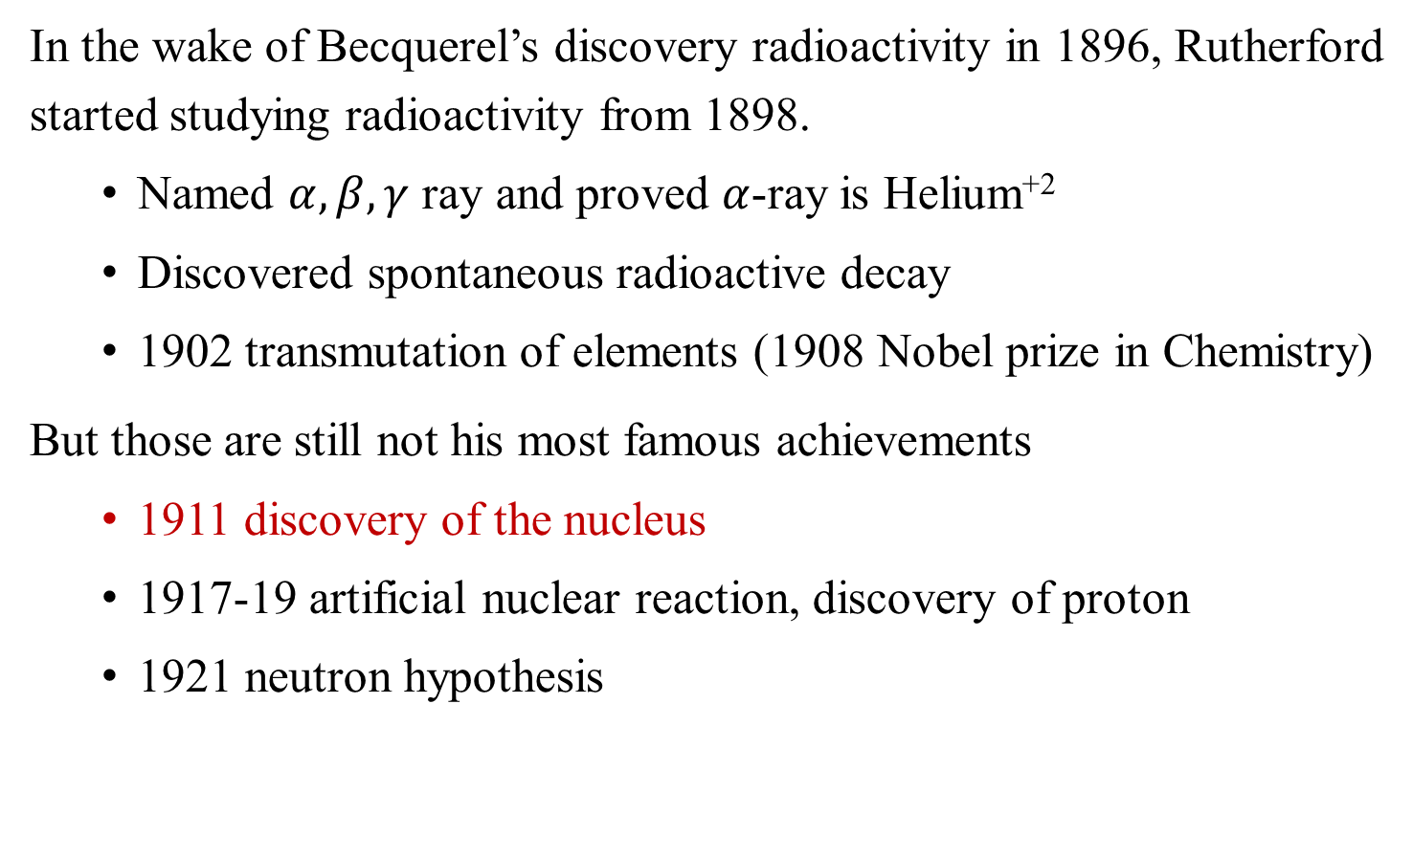
Ernest Rutherford
In the wake of Becquerel’s discovery radioactivity in 1896, Rutherford started studying radioactivity from 1898.
  Named $α,β,γ$ ray and proved $α$-ray is Helium⁺²
  Discovered spontaneous radioactive decay
  1902 transmutation of elements (1908 Nobel prize in Chemistry)
But those are still not his most famous achievements
  1911 discovery of the nucleus
  1917-19 artificial nuclear reaction, discovery of proton
  1921 neutron hypothesis
Notes:
The golden age of radioactivity.
Rutherford came from a farmer’s family in New Zealand. After graduating from university, he received a scholarship for postgraduate study at the Cavendish Laboratory, University of Cambridge. There, he was guided by Thomson. After completing his postgraduate studies in 1898, he joined McGill University in Canada. Inspired by Becquerel's discoveries, he began studying radioactive substances.
According to a recent research, the level of academic activity for Nobel Prize winners decreases by 30% after receiving the award.
But Rutherford is the opposite. He is regarded as the greatest experimental physicist since Faraday.
Artificial nuclear reaction: Bombarding nitrogen gas with alpha particles to produce oxygen and protons.

Slide 4
Alpha, Beta and Gamma rays
X-rays like radiation with even shorter wavelengths
He⁺²
electron
Alpha 衰变： https://en.wikipedia.org/wiki/Alpha_decay
Notes:
Rutherford's discovery of the nucleus was made by alpha particles scattering experiment.
In nuclear physics, the three most famous common types of radiation are the alpha, beta, and gamma radiations, where alpha particle are helium+2 ions, beta particles are electrons, and gamma radiation are high-energy em waves with wavelengths shorter than that of X-rays.
Since alpha rays are positively charged, beta rays are negatively charged, and gamma rays are neutral, they can be easily distinguished using a magnetic field. These three types of radiation were all named by Rutherford.
It was Rutherford who discovered that alpha rays are Helium ions with a +2 charge, which is just the nucleus of Helium.
Radon gas undergoes alpha decay, emitting alpha particles. This process produces alpha radiation with an energy of around 5 MeV and a speed about 5% of the speed of light.

Slide 5
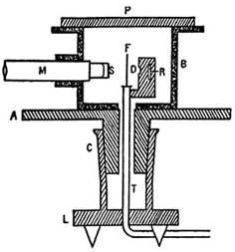
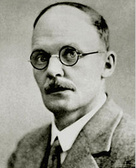
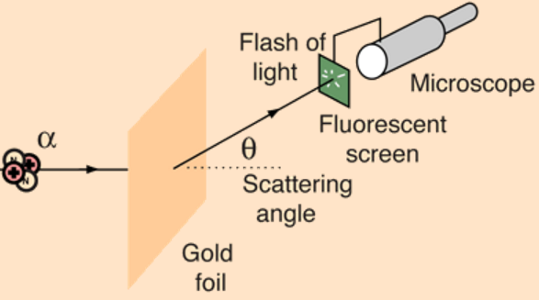
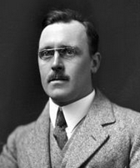
Rutherford-Geiger-Marsden experiment (1909-1911)
Geiger
Initially, the counting was done by eyes.
Latter, Geiger invented Geiger counter.
Marsden
F: gold foil (0.1 micron)，R: radon-222， S: scintillation screen，M: microscope
Notes:
卢瑟福和助手盖革一起开始做这个实验。穿过金箔的alpha粒子打在一个闪烁屏上会发出荧光，被后面的显微镜观察到。
At first the experiments was quite difficult. Observations could only be taken in a dark laboratory, and it took about half an hour for the observer's eyes to adjust to seeing the traces. Each observer could only count accurately for about a minute before they needed to swap over.
**If the reader wants to see scintillations, all he has to do is to look at the figures on a luminous watch dial with a magnifying glass.
Geiger later（1908） developed the 'Geiger counter', which could count these pulses automatically in normal light. It made similar experiments much easier!
In 1909 Geiger needed an experiment for a research student, Ernest Marsden. Rutherford suggested that Marsden look for alpha-particle scattering at large angles. 盖革要给报名“曦源项目” 的Marsden找件事做做。于是卢瑟福建议让Marsden观察一下大角度散射的情况。

Slide 6
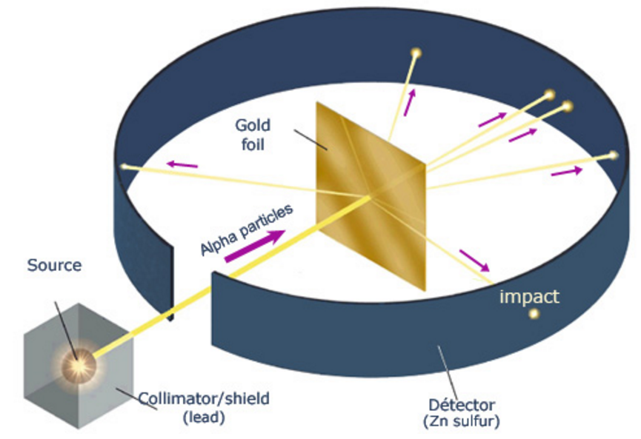

The result of the scattering experiment
$$θ$$
闪烁屏
About 1 in 8000 particles deflected more than $90°$
Notes:
实验结果发现的确有背散射的现象，而且大约有八千分之一的粒子偏转角超过了90度！
卢瑟福大为吃惊。让我们来看看他为何惊讶。

Slide 7
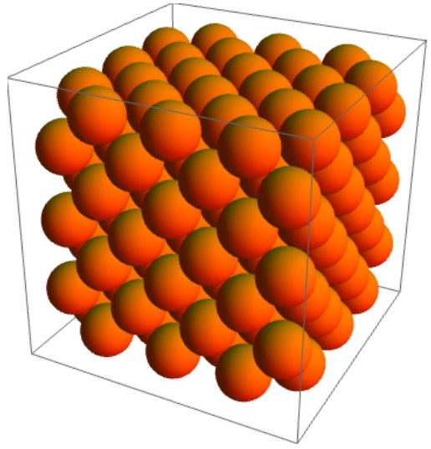
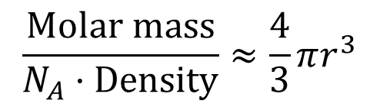
The size of an atom
$$\frac{Molar mass}{N_{A}·Density}≈\frac{4}{3}πr^{3}$$
Assuming dens packing
Notes:
尽管不同物质质量密度差别很大，但数密度和原子半径差别很小. 这个现象的原因要等我们学了量子力学才能够解释。

Slide 8
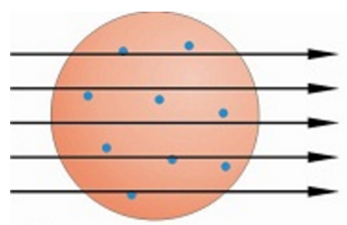
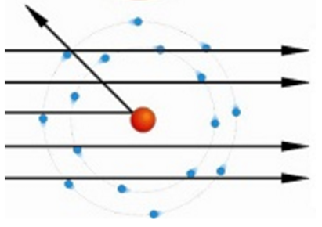
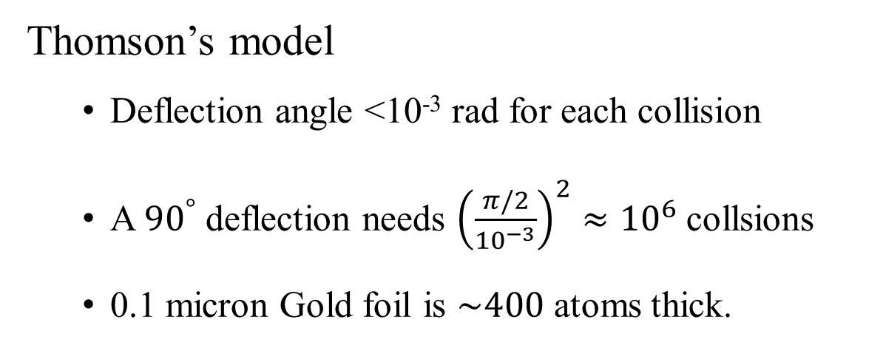
The failure of Thomson’s model
Thomson’s model
  Deflection angle <10⁻³ rad for each collision
  A ${90}^{°}$ deflection needs ${\left(\frac{π/2}{{10}^{−3}}\right)}^{2}≈{10}^{6}$ collsions
  0.1 micron Gold foil is $\sim 400$ atoms thick.
Rutherford’s model
Notes:
根据Thomson模型。。。。，大角度散射的几率极低, “就像炮弹打到纸上被弹了回来”
因此这个实验结果启发卢瑟福马上想到一个新的原子模型， 即如左图所示：
除了电子，原子中的其他物质全部集中在很小的区域里，形成一个所谓的原子核。它带正电，并且质量很大。
只有这样才能够对alpha粒子产生大角度散射。（试试看，你能不能提出其他模型？比如还有部分中性物质是均匀分布的）
这个实验室1909年做的，但是卢瑟福并没有马上发表这一结果。因为一个好的物理理论必须能够量化，才可以和实验做比较。

Slide 9
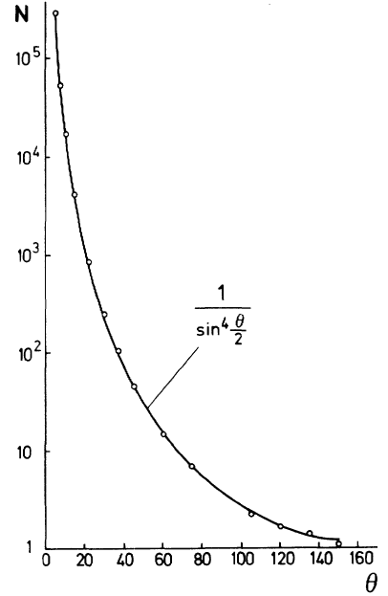



The proof of Rutherford’s model (1911)
$$ΔN$$
$$ΔN(θ)∝\frac{1}{\sin^{4}{\frac{θ}{2}}}$$
Rutherford spent 2 years on measuring the deflection angle dependence of the scattering probability before finally published his atomic model
$ΔN(θ)$: # of particles deflected by $θ$

Slide 10
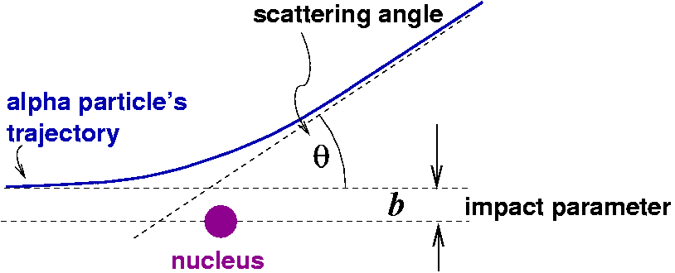
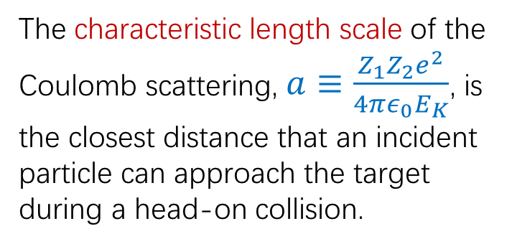

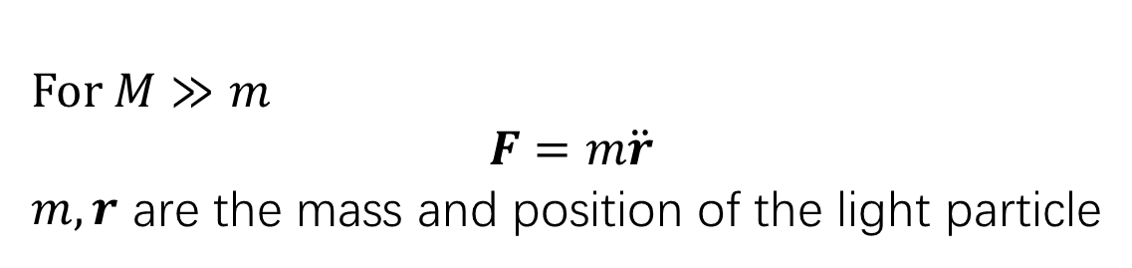

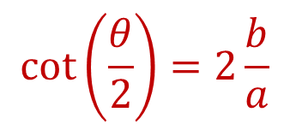

Coulomb scattering
$$\cot\left(\frac{θ}{2}\right)=2\frac{b}{a}$$
$$m,Z_{1}e$$
初始动能$E_{K}$
$$M, Z_{2}e$$
For $M≫m$
$$F=m\ddot{r}$$
$m,r$ are the mass and position of the light particle
The characteristic length scale of the Coulomb scattering, $a≡\frac{Z_{1}Z_{2}e^{2}}{4πε_{0}E_{K}}$, is the closest distance that an incident particle can approach the target during a head-on collision.
Notes:
Since the interaction between two charged particles during a collision is governed by the Coulomb force, this process is referred to as Coulomb scattering.
Let us first examine the trajectory of the particles in this scattering process. Since the mass of the target (gold nucleus) is much larger than that of the incident alpha particle. We can approximate the target nucleus as having an infinite mass, meaning it does not move during the scattering process.
Let Z1​ and Z2​ denote the charge number of the incident and target particles, Ek denotes the initial kinetic energy of the incident particle​, and b denotes the impact parameter, which is the perpendicular distance between the incident velocity and the target nucleus.
Our goal is to determine the moving direction of the alpha particle after the scattering, referred to as the scattering angle θ
Let us start by making an educated guess. When b=0, the incident particle directed at the target nucleus head-on, so it will eventually be bounced back along its original path, meaning θ=π. When b becomes very large, the Coulomb force weakens significantly, so the scattering angle θ will approach 0.
But what defines “large” or “small” for b? What is the characteristic length scale of this system?
For a 5 MeV alpha particle, the distance of the closest approach a is approximately 45 fm (femtometer).
The process of calculating the scattering angle is quite complex and does not offer much new insight, so we will skip the detailed steps and directly present the fina relationship. The result is surprisingly simple and is known as the Coulomb scattering formula. To our delight, the curve plotting θθ versus bb based on this formula aligns very well with our earlier estimates.
New chat

Slide 11
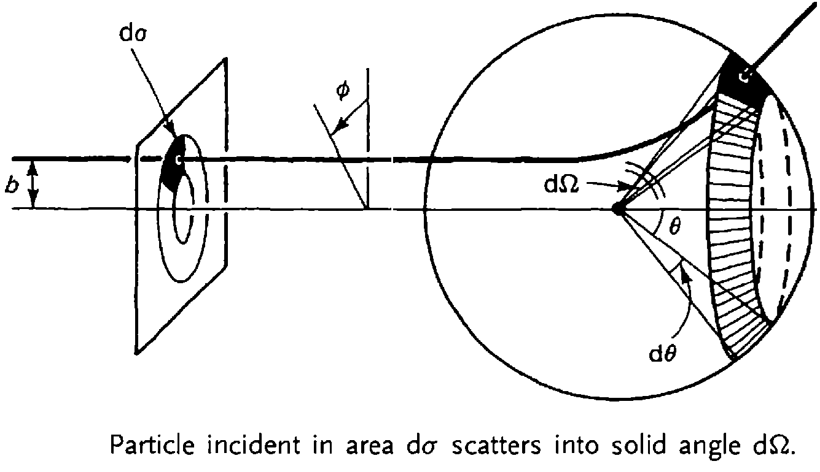

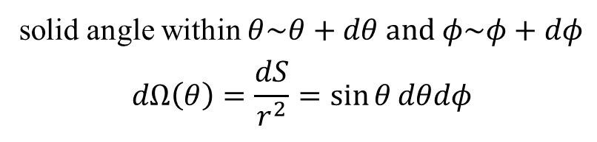
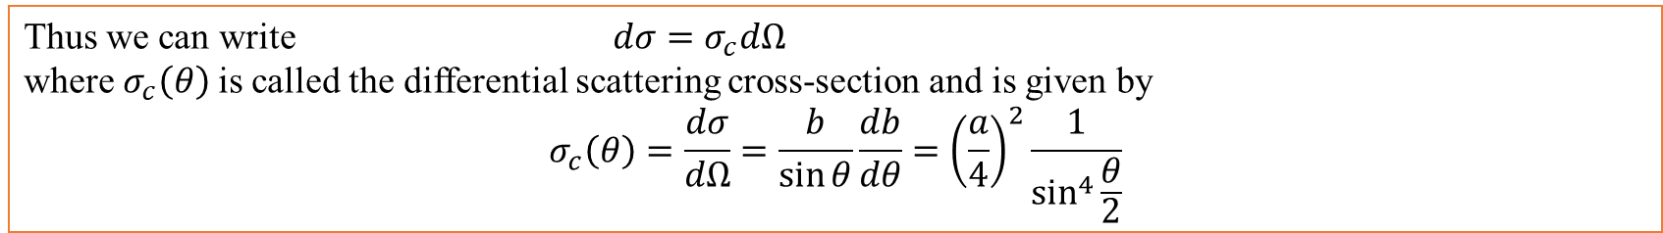

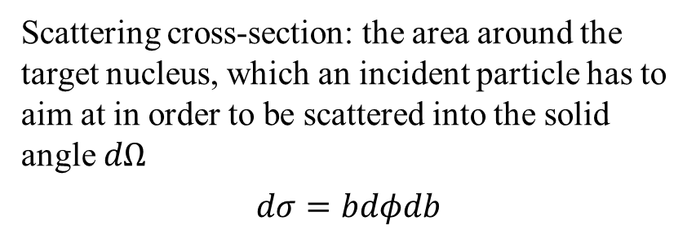
Differential scattering cross-section
solid angle within $θ\sim θ+dθ$ and $φ\sim φ+dφ$
$$dΩ\left(θ\right)=\frac{dS}{r^{2}}=\sin{θ}dθdφ$$
$$d$$
Scattering cross-section: the area around the target nucleus, which an incident particle has to aim at in order to be scattered into the solid angle $dΩ$
$$dσ=bdφdb$$
$$b=\frac{a}{2}\cot\left(\frac{θ}{2}\right)$$
Thus we can write $dσ=σ_{c}dΩ$
where $σ_{c}\left(θ\right)$is called the differential scattering cross-section and is given by
$$σ_{c}\left(θ\right)=\frac{dσ}{dΩ}=\frac{b}{\sin{θ}}\frac{db}{dθ}={\left(\frac{a}{4}\right)}^{2}\frac{1}{\sin^{4}{\frac{θ}{2}}}$$
Notes:
Consider one target nucleus, such a scattering process exhibits rotational symmetry around the axis that passes through the target nucleus in the incident direction.
For incident particles with the same impact parameter b, the scattering angles θ(b) are identical.
All and only the alpha particles incident on the shaded area dσ will be scattered into the solid angle dΩ.

Slide 12

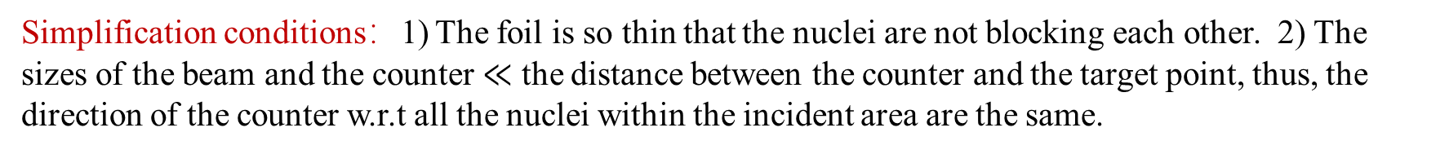
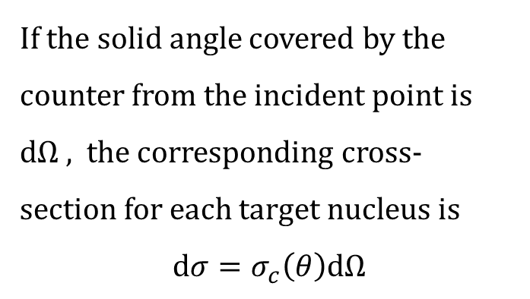
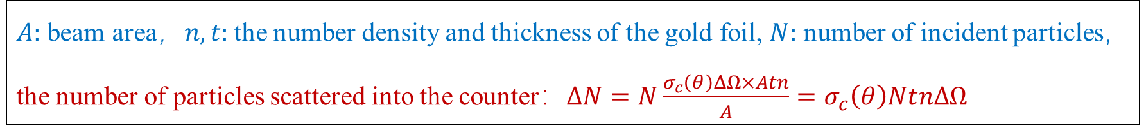
How many $α$-particles get to the counter?
If the solid angle covered by the counter from the incident point is $dΩ$, the corresponding cross-section for each target nucleus is
$$dσ=σ_{c}\left(θ\right)dΩ$$
Simplification conditions：1) The foil is so thin that the nuclei are not blocking each other. 2) The sizes of the beam and the counter $≪$ the distance between the counter and the target point, thus, the direction of the counter w.r.t all the nuclei within the incident area are the same.
$A:$ beam area，$n,t:$ the number density and thickness of the gold foil, $N:$ number of incident particles，
the number of particles scattered into the counter：$ΔN=N\frac{σ_{c}\left(θ\right)ΔΩ×Atn}{A}=σ_{c}\left(θ\right)NtnΔΩ$
Notes:
Now, let’s apply this formula to the real situation in the experiment.

Slide 13
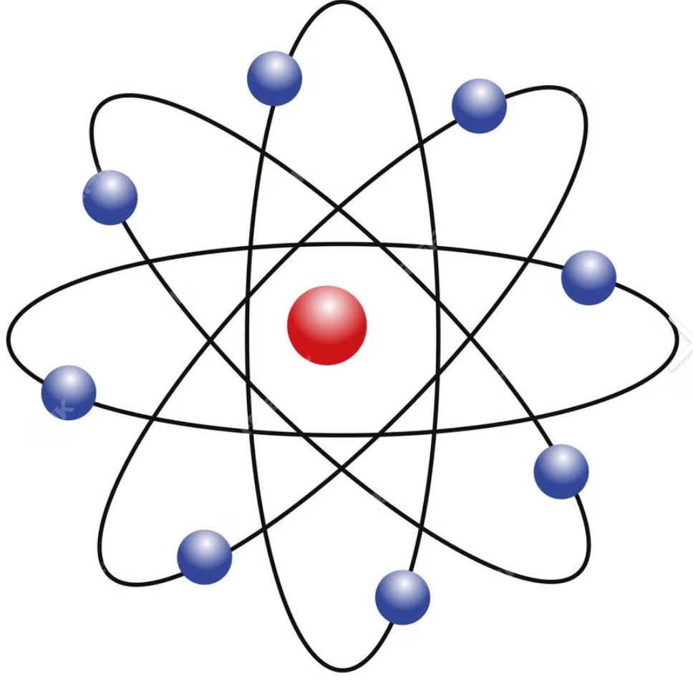
New problem arises
Rutherford’s model perfectly explained the result of his scattering experiment
However according to classical electrodynamics, an accelerating charge emits radiation and loses its energy. The electrons can only orbit for a few nanoseconds before falling into the nucleus.
Notes:
Rutherford‘s reply was: “My model only answers what exists inside an atom. It is not responsible for explaining what happens between the nucleus and the electrons.“
This statement sounds confident, but it implies that he could not resolve this contradiction.
Physics is a rigorous science; it does not allow any internal contradictions. Whenever a contradiction arises, it shows that something is wrong within
the existing theory.
If Rutherford's atomic model were correct, then classical electrodynamics must be wrong?
Do we really understand electromagnetic waves?

Slide 14
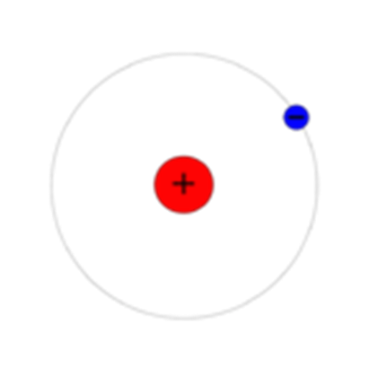

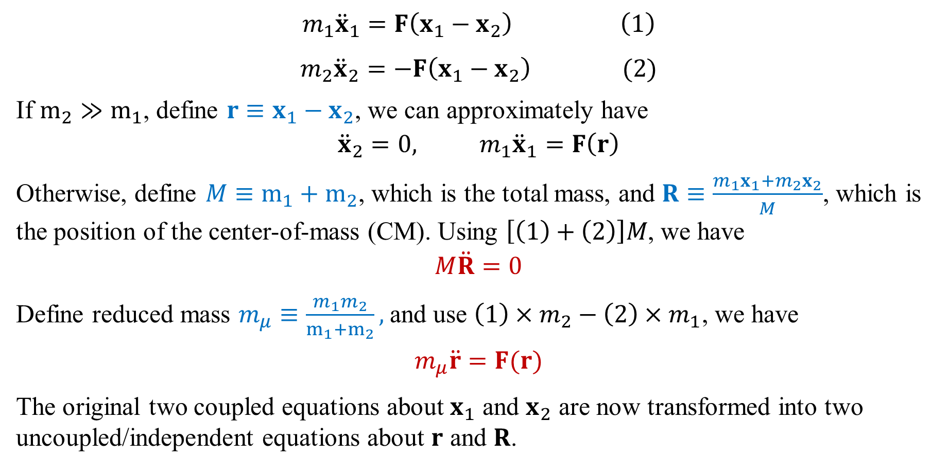




The two-body problem
$$m_{1}$$
$$m_{1}{\ddot{x}}_{1}=F\left(x_{1}−x_{2}\right) \left(1\right)$$
$m_{2}{\ddot{x}}_{2}=−F\left(x_{1}−x_{2}\right) (2)$
If $m_{2}≫m_{1}$, define $r≡x_{1}−x_{2}$, we can approximately have
$${\ddot{x}}_{2}=0, m_{1}{\ddot{x}}_{1}=F\left(r\right)$$
Otherwise, define $M≡m_{1}+m_{2}$, which is the total mass, and $R≡\frac{{m_{1}x}_{1}+m_{2}x_{2}}{M}$, which is the position of the center-of-mass (CM). Using $\left[\left(1\right)+\left(2\right)\right]M$, we have
$$M\ddot{R}=0$$
Define reduced mass $m_{μ}≡\frac{m_{1}m_{2}}{m_{1}+m_{2}},$and use $\left(1\right)×m_{2}−\left(2\right)×m_{1}$, we have
$$m_{μ}\ddot{r}=F(r)$$
The original two coupled equations about $x_{1}$ and $x_{2}$ are now transformed into two uncoupled/independent equations about $r$ and $R$.
$$m_{2}$$
$$F$$
$$x_{1}$$
$$x_{2}$$
Notes:
本来m1的运动方程里有x2，m2的方程里有x1

Slide 15
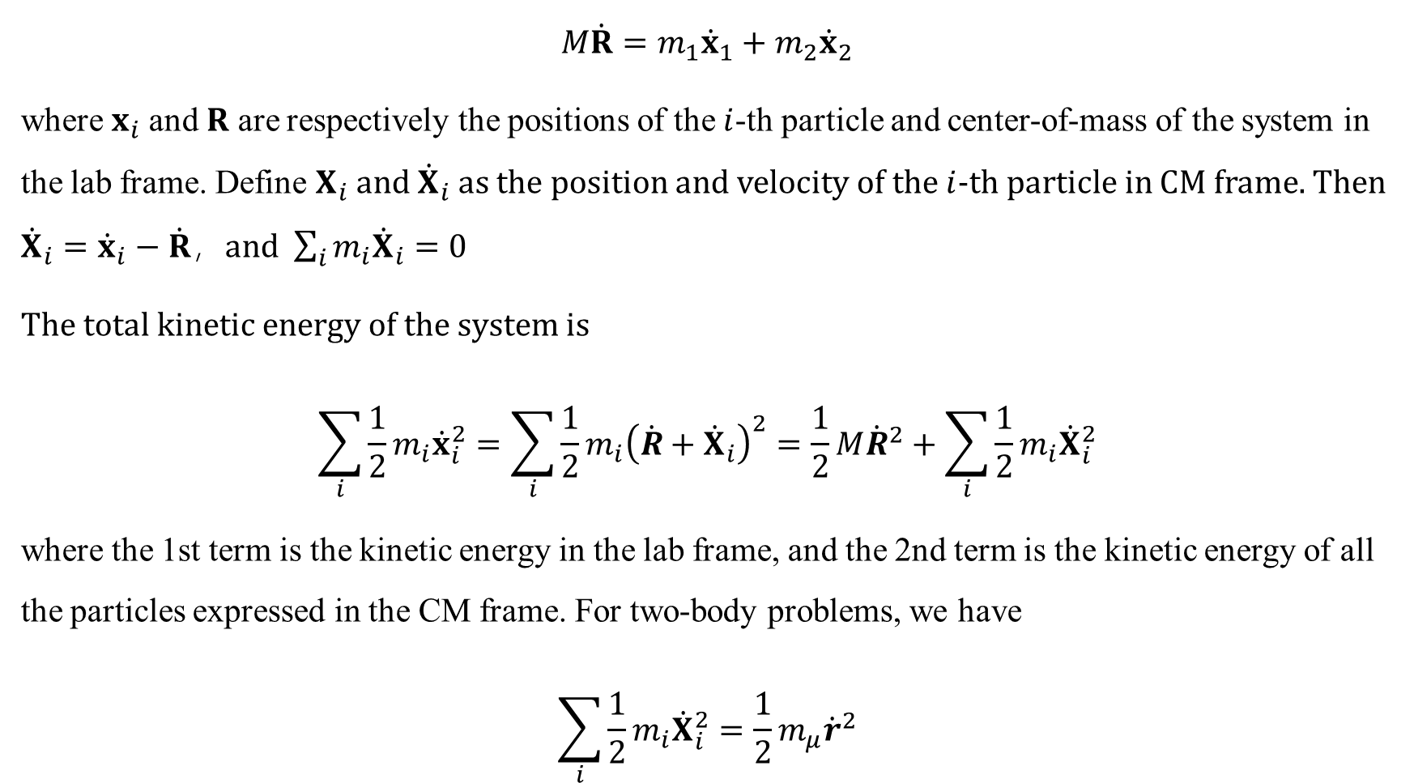
Total kinetic energy in the Lab and the center-of-mass reference frames
$$M\dot{R}={m_{1}\dot{x}}_{1}+m_{2}{\dot{x}}_{2}$$
where $x_{i}$and $R$ are respectively the positions of the $i$-th particle and center-of-mass of the system in the lab frame. Define $X_{i}$ and ${\dot{X}}_{i}$ as the position and velocity of the $i$-th particle in CM frame. Then ${\dot{X}}_{i}={\dot{x}}_{i}−\dot{R}$，and $\sum_{i}{m_{i}{\dot{X}}_{i}}=0$
The total kinetic energy of the system is
$$\sum_{i}{\frac{1}{2}m_{i}{\dot{x}}_{i}^{2}}=\sum_{i}{\frac{1}{2}m_{i}{\left(\dot{R}+{\dot{X}}_{i}\right)}^{2}}=\frac{1}{2}M{\dot{R}}^{2}+\sum_{i}{\frac{1}{2}m_{i}{\dot{X}}_{i}^{2}}$$
where the 1st term is the kinetic energy in the lab frame, and the 2nd term is the kinetic energy of all the particles expressed in the CM frame. For two-body problems, we have
$$\sum_{i}{\frac{1}{2}m_{i}{\dot{X}}_{i}^{2}}=\frac{1}{2}m_{μ}{\dot{r}}^{2}$$

Slide 16
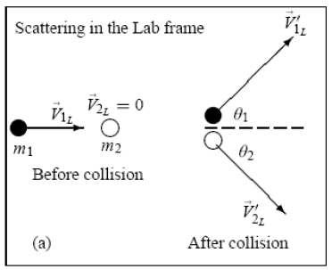
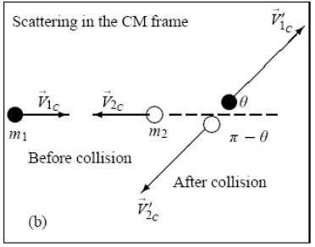

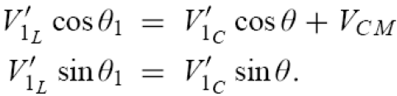

*Transformation between the lab and the CM reference frame

Slide 17
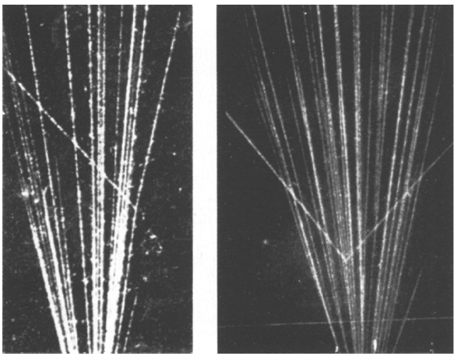

$α$粒子在云室内的轨迹
Notes:
If m2 is initially at rest, the angle between the momenta of the two particles after the collision depends on the mass ratio m1/m2
If m1=m2，the angle = 90°
If m1>m2，the angle < 90°
If m1<m2，the angle > 90°

